Slide 1

Stage 7 Feeling Stressed Course Designer: Xuzi Zhou
Feeling Stressed is a 16 round, 80 point, COMSTOCK Medium course. There are 7 IPSC targets and 2 steel targets. The best two hits per target will score. Steel must fall to score. The start signal is audible.
The Handgun start position is standing with heels touching start stick and wrists below belt. Handgun is loaded and holstered. The PCC start position is standing with heels touching start stick with PCC loaded, stock on belt, safety on.
On the audible start signal, engage all targets from within the shooting areas. P2 activates Swinger which is visible at rest.

Slide 2
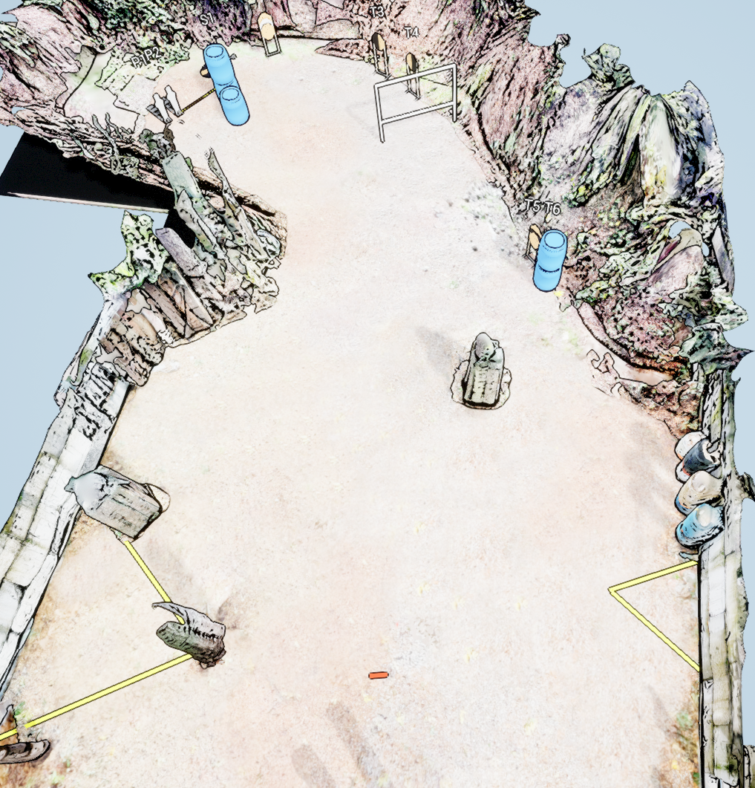
 | Stage 7 Feeling Stressed Course Designer: Xuzi Zhou

